Slide 1
أكـــــاديميــــة طــــويـــق
Scalable Data Science

Slide 2
Deploying GPU-accelerated data pipelines
By: Dr. Afshan Hashmi

Slide 3
Course Objectives:
Understand the architecture and benefits of GPU-accelerated computing
Design efficient data pipelines for GPU processing
Implement GPU-accelerated data transformations
Optimize pipeline performance through benchmarking
Deploy GPU pipelines in production environments
Monitor and maintain GPU-accelerated systems

Slide 4
Fundamentals of GPU Computing

Slide 5
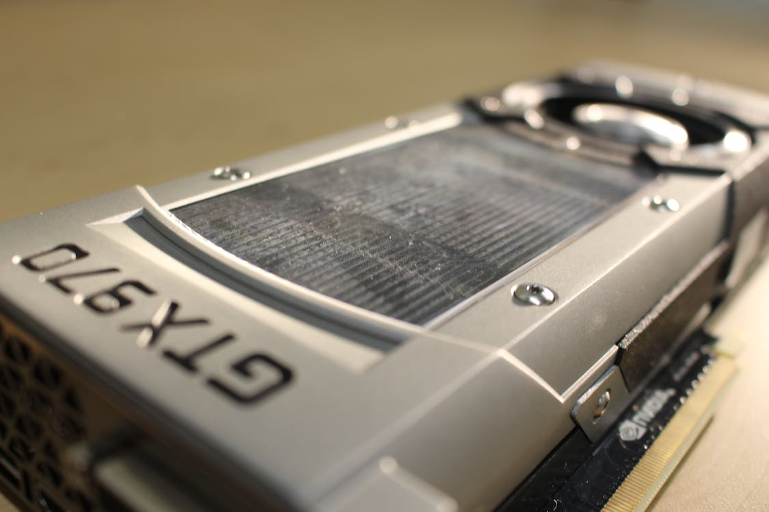
Introduction to GPU Architecture
What is a GPU?
GPU stands for Graphics Processing Unit.
Originally designed for rendering images and video.
Now widely used for parallel computation in scientific computing, deep learning, etc.
Originally, GPUs (Graphics Processing Units) were developed to handle the intensive mathematical calculations needed to render graphics and images. However, due to their highly parallel structure having thousands of lightweight cores they are now extensively used in fields beyond graphics.

Slide 6
Applications of GPU
Scientific Computing: Tasks such as simulations, numerical methods, and modeling large datasets (e.g., weather forecasting, molecular dynamics) benefit from GPU parallelism.
Deep Learning: Training neural networks involves large matrix operations and backpropagation, which are efficiently handled by GPUs.
Other: Other applications include cryptography, financial modeling, medical imaging, real-time data analytics, and more.

Slide 7
CPU vs GPU: Architectural Differences
Feature | CPU | GPU
Optimized For | Low latency, sequential task execution | High throughput, parallel execution
Cores | Few complex cores | Thousands of simpler cores
Control Logic | Complex | Simplified
Threading | Limited | Massive parallelism

Slide 8
Key GPU Components
CUDA Cores: Execution units in NVIDIA GPUs responsible for computation.
Streaming Multiprocessors (SMs): Group of CUDA cores sharing resources.
Memory Hierarchy:
Global Memory: Large but slow, shared across all SMs.
Shared Memory: Faster, shared within a single SM.
Registers: Fastest, private to individual threads.
Constant & Texture Memory: Read-only, optimized for specific access patterns.

Slide 9
CUDA cores
CUDA cores are the basic processing elements within NVIDIA GPUs. Think of them as tiny, simplified CPU cores that can execute thousands of operations in parallel. Here’s what makes them special:
CUDA stands for Compute Unified Device Architecture — a parallel computing platform developed by NVIDIA.
Each CUDA core can perform arithmetic and logic operations (like addition, multiplication) on data.
In a GPU, hundreds to thousands of CUDA cores work together to handle tasks that are divided into many small, independent parts — this is ideal for parallel processing (e.g., image processing, matrix multiplication, deep learning).
They reside within larger units called Streaming Multiprocessors (SMs), which group multiple CUDA cores to operate together efficiently.
Analogy: If a CPU is a few skilled workers doing one task at a time, a GPU with CUDA cores is like an army of helpers doing many tasks simultaneously.

Slide 10
Streaming Multiprocessor (SM)
A Streaming Multiprocessor (SM) is a fundamental building block of an NVIDIA GPU. Each SM contains:
Multiple CUDA cores (the units that do computations),
Shared resources like registers, shared memory, and instruction schedulers.
The CUDA cores inside an SM work together, executing instructions in parallel. Threads running the same kernel are grouped into warps (typically 32 threads), and these warps are scheduled by the SM.
It’s Importance:
SMs allow massive parallelism, which is key to GPU acceleration.
The efficiency of your GPU program depends heavily on how well it utilizes the SM's shared resources and memory hierarchy.
Understanding SMs helps optimize thread and memory usage in CUDA programs.

Slide 11
Memory Hierarchy
In GPU computing, memory hierarchy refers to the different types of memory available within
the GPU and how they differ in speed, size, and scope. Understanding this hierarchy is crucial for
writing efficient GPU code. Here's a breakdown of the key memory types:
Memory Type | Location | Access Scope | Speed | Usage Notes
Registers | Per thread | Fastest access (private) | ⚡⚡⚡⚡⚡ | Used for local variables inside each thread. Limited in size.
Shared Memory | Per SM (block) | Shared within a block | ⚡⚡⚡⚡ | Very fast. Ideal for cooperation among threads in the same block.
Global Memory | Device-wide | All threads can access | ⚡⚡ | High latency. Use efficiently-avoid frequent accesses.
Constant Memory | Device-wide | Read-only for threads | ⚡⚡⚡ | Optimized for broadcast-style access.
Texture/Surface | Specialized cache | Read-only (often 2D/3D)

Slide 12
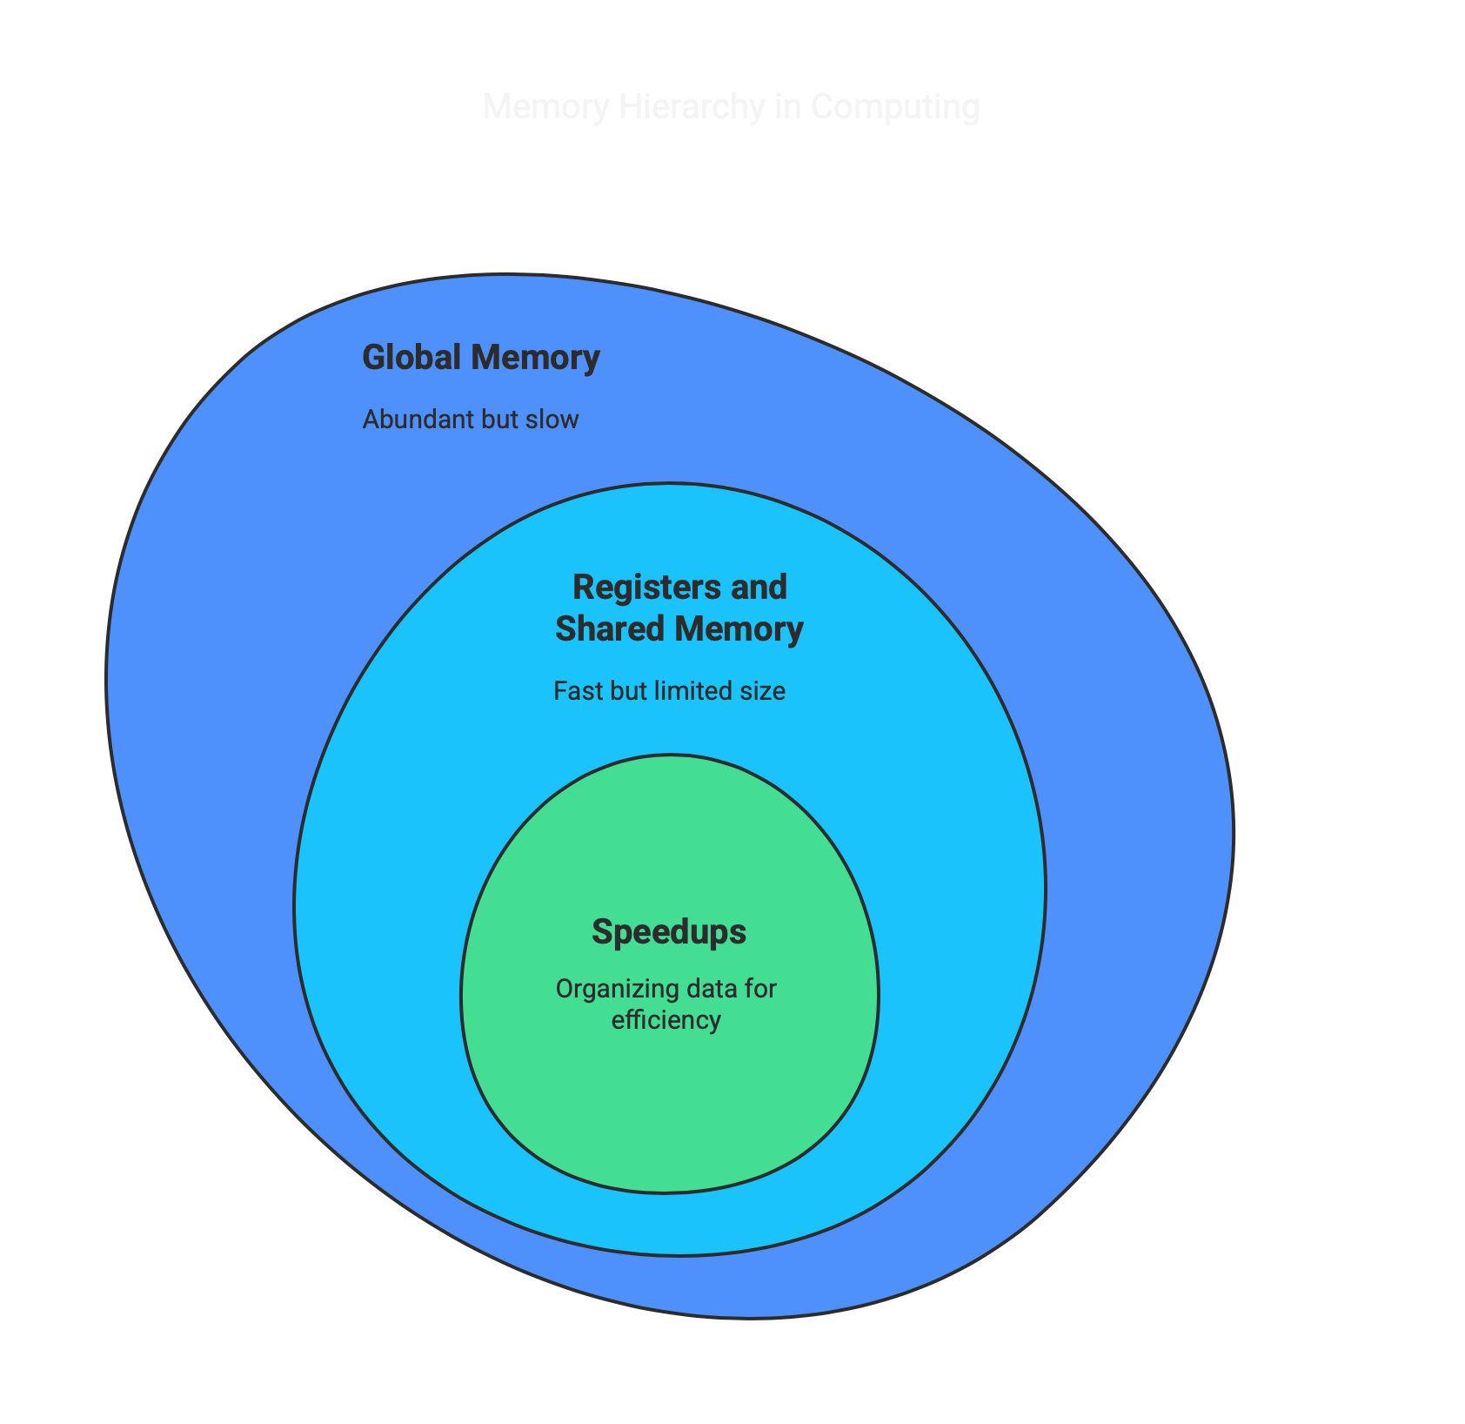
Importance of Memory Hierarchy
Performance is greatly influenced by how you use memory.
Registers and shared memory are fast but limited in size.
Global memory is abundant but slow, so minimizing access or coalescing it is key.
Organizing data and computation to match this hierarchy results in massive speedups.

Slide 13
Memory Bandwidth & Latency
When working with GPUs, two critical performance concepts to understand are memory bandwidth and latency:
Memory Bandwidth
This is the maximum rate at which data can be transferred between the GPU’s memory and its processing cores.
Think of it like the width of a highway—the wider it is, the more cars (data) can travel at the same time.
GPUs are designed with very high bandwidth to move massive amounts of data quickly for parallel tasks like image processing or deep learning.
Memory Latency
Latency is the delay between issuing a memory request and receiving the data.
Imagine latency as the reaction time before a car even starts moving on the highway.
GPUs have relatively high latency compared to CPUs because they prioritize throughput (moving a lot of data fast), not instant response.

Slide 14
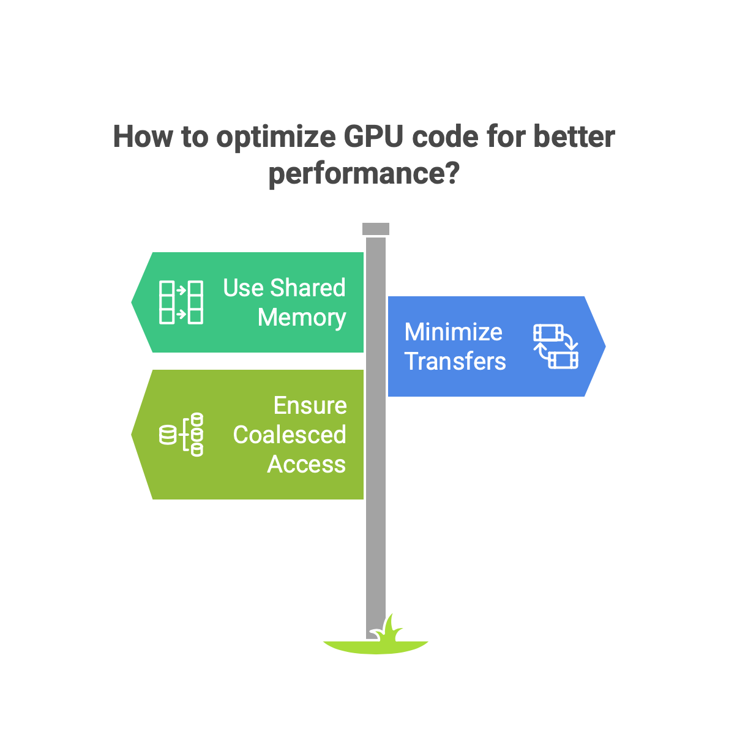
Importance of Memory Bandwidth & Latency
Although GPUs have high bandwidth, latency can still hurt performance if your code makes many small, random accesses to global memory.
To optimize GPU code, you should:
Use shared memory when possible (it’s much faster).
Minimize transfers between the CPU (host) and GPU (device).
Ensure memory access is coalesced (threads access data in contiguous blocks).

Slide 15
GPU Programming Models
These are three major frameworks or platforms for GPU programming:
CUDA, OpenCL, ROCm Comparison
Feature | CUDA | OpenCL | ROCm
Vendor | NVIDIA | Open standard (AMD, Intel, NVIDIA) | AMD
Language | CUDA C/C++ | OpenCL C | HIP/C++
Portability | Low (NVIDIA only) | High | Medium
Community Support | Strong | Moderate | Growing

Slide 16
Data Parallelism vs Task Parallelism
These are two approaches to organizing computations for parallel execution:
Data Parallelism
The same operation is applied to multiple data elements simultaneously.
Perfectly suited for GPU architectures.
Example: Adding two vectors element-wise—each GPU thread handles one element.
Task Parallelism
Different tasks or functions run in parallel, often on separate threads.
More common in CPU-based parallelism or when operations are diverse.
Example: One thread reads data, another processes it, another saves it.
Why Its important:
GPUs are built for data parallelism with thousands of lightweight cores that work best when doing identical tasks on large data sets.
Task parallelism is more complex and less efficient on GPUs but works well on CPUs.

Slide 17
Kernel Execution Model
This model explains how a GPU executes a program, especially under CUDA or similar frameworks.
Host vs Device
Host: Your CPU and RAM — responsible for launching GPU tasks.
Device: The GPU — does the heavy lifting of parallel computation.
A CPU (host) sends instructions to the GPU (device), usually in the form of a function called a kernel.
Kernel
A kernel is a function that runs on the GPU.
When launched, it's executed simultaneously by many threads.

Slide 18
Kernel Execution Model
Thread Hierarchy
To organize so many threads, CUDA uses a three-level hierarchy:
Threads — Individual units of execution.
Blocks — A group of threads.
Grid — A collection of blocks.
This makes it easy to scale computations across thousands of threads.
Calculating Thread ID
Each thread needs a unique index to access its specific portion of data.
int thread_id = blockIdx.x * blockDim.x + threadIdx.x;
This formula is used in CUDA programming to uniquely identify each GPU thread when running a kernel.
Here's what each term means:
threadIdx.x: The index of the thread within its block.
blockDim.x: The number of threads in each block.
blockIdx.x: The index of the block within the grid.

Slide 19
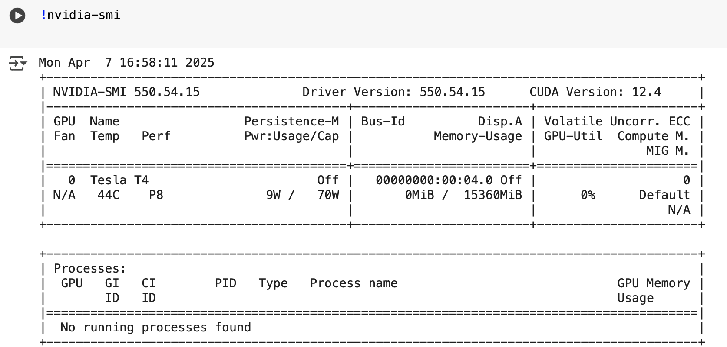
GPU Hardware Exploration
Use terminal commands to explore GPU properties.
NVIDIA Systems:
This shows:
Current GPU usage (e.g., memory usage, temperature)
Active processes using the GPU
GPU model, driver version, and compute capabilities

Slide 20
Data Pipeline Design for GPU Acceleration

Slide 21
Pipeline Design Principles
Data Flow Patterns for GPU Acceleration
Data pipelines consist of stages where data flows through various processes. In the context of GPU acceleration, understanding how data moves between these stages is key to optimizing performance.
Batch Processing:
Process large chunks of data in parallel, suited for workloads where all data is available at once (e.g., deep learning model training).
GPUs excel at processing large batches efficiently because they are designed for parallelism.
Streaming Processing:
Continuously process data as it becomes available (e.g., real-time analytics).
GPUs are less suited for streaming due to potential latency and challenges in maintaining real-time throughput.
Hybrid Models:
Some applications use a combination of batch and streaming (e.g., video processing) where frames are processed in batches while streaming.

Slide 22
Memory Management Strategies
Efficient memory management is crucial for leveraging GPU capabilities:
Global Memory:
Large, but slower compared to other types of memory.
Shared across all threads.
Minimize transfers between host and device to reduce bottlenecks.
Shared Memory:
Faster memory within a single streaming multiprocessor (SM).
Use shared memory for temporary data that is accessed frequently by threads in the same block.
Constant Memory:
Used for read-only data that doesn't change during kernel execution.
Great for storing constants like model parameters in deep learning.
Memory Coalescing:
Ensures that memory accesses by threads in a warp are coalesced, meaning they are combined into fewer transactions for efficient access.

Slide 23
Common Pipeline Operations
GPU-Accelerated ETL Operations
ETL (Extract, Transform, Load) operations are commonly used to preprocess data for analysis or machine learning.
Extract:
Load data from external sources (e.g., databases, files).
GPUs can accelerate extraction, especially for tasks like parsing large datasets or loading images.
Transform:
Feature transformations (e.g., scaling, encoding, normalization).
GPUs speed up data transformation by using parallelization to apply these transformations across large datasets quickly.
Load:
Insert the processed data into storage.
While the loading process itself is typically CPU-bound, GPUs can speed up post-processing for loading tasks that involve computation (e.g., aggregation, sorting).

Slide 24
Feature Engineering Transformations
Parallelization of Feature Engineering: GPUs can process features in parallel, allowing fast calculations of statistical features (e.g., mean, variance, correlations) or encoding tasks like one-hot encoding for categorical variables.
Dimensionality Reduction:
Techniques like PCA or t-SNE can be accelerated by leveraging GPU computation power.
a. Principal Component Analysis (PCA)
PCA is a statistical technique used to transform a dataset into a set of orthogonal (uncorrelated) components, ranked by variance. This allows you to reduce the dataset's dimensionality while preserving the most important information.
b. t-SNE
t-SNE is another technique used for dimensionality reduction, particularly for visualizing high-dimensional data by mapping it to a lower-dimensional space (usually 2D or 3D). It's effective in preserving the local structure of the data, making it suitable for exploratory data analysis.

Slide 25
Why GPUs Are Beneficial for These Tasks
Parallel Processing: Both PCA and t-SNE involve operations that can be parallelized, such as matrix multiplications or distance calculations. GPUs can handle these tasks in parallel across multiple cores, reducing the time complexity of the algorithms.
Speed: GPUs are designed to process large amounts of data in parallel, making them much faster than CPUs for operations like encoding, feature transformations, and matrix decompositions.
Scalability: Using GPUs makes it possible to scale up the feature engineering process for larger datasets, allowing data scientists to process datasets that wouldn't be feasible with CPU-based methods.
In summary, parallelization of feature engineering tasks and dimensionality reduction techniques can be greatly accelerated by using GPUs. Whether it's calculating statistical features, encoding categorical variables, or applying dimensionality reduction algorithms like PCA and t-SNE, GPUs provide significant performance improvements, making them a valuable tool in the data preprocessing pipeline, especially for large datasets.

Slide 26
Data Augmentation Techniques
Data Augmentation Techniques
Data augmentation is a key technique in machine learning and deep learning that involves creating new, slightly modified versions of existing data to improve the generalization ability of models. This is particularly crucial when dealing with limited datasets, as augmentation can synthetically increase the dataset size and variability without the need for additional data collection.
With the ever-increasing size of datasets and the complexity of augmentation methods, GPUs have become essential in speeding up the process, ensuring that training pipelines remain efficient and scalable.
Image Augmentation:
GPUs are widely used for accelerating image augmentations such as flipping, cropping, rotating, and color adjustment.
Text Augmentation:
Parallel transformations like tokenization or paraphrasing can be sped up on GPUs.
Audio Augmentation:
Techniques like pitch shifting, noise addition, and time warping can be done in parallel using GPU acceleration.

Slide 27
GPU Advantages:
Audio transformations often involve FFTs (Fast Fourier Transforms), spectrogram generation, and convolution all operations that benefit from GPU parallelism.
Libraries like TorchAudio, Kapre (Keras), and NVIDIA NeMo support GPU-accelerated audio preprocessing and augmentation.
Parallel batch processing of audio clips on the GPU dramatically reduces the time required for real-time augmentation during model training.
Faster processing of large batches.
On-the-fly augmentation without pre-generating and storing augmented data.
Scalability in high-throughput data pipelines.
By accelerating image, text, and audio augmentations using GPUs, data scientists and ML engineers can achieve faster model convergence, better generalization, and more efficient training workflows.

Slide 28
Data Augmentation Techniques
GPU Advantages:
Audio transformations often involve FFTs (Fast Fourier Transforms), spectrogram generation, and convolution all operations that benefit from GPU parallelism.
Libraries like TorchAudio, Kapre (Keras), and NVIDIA NeMo support GPU-accelerated audio preprocessing and augmentation.
Parallel batch processing of audio clips on the GPU dramatically reduces the time required for real-time augmentation during model training.
Faster processing of large batches.
On-the-fly augmentation without pre-generating and storing augmented data.
Scalability in high-throughput data pipelines.
By accelerating image, text, and audio augmentations using GPUs, data scientists and ML engineers can achieve faster model convergence, better generalization, and more efficient training workflows.

Slide 29
Data Augmentation Techniques
GPU Advantages:
Audio transformations often involve FFTs (Fast Fourier Transforms), spectrogram generation, and convolution all operations that benefit from GPU parallelism.
Libraries like TorchAudio, Kapre (Keras), and NVIDIA NeMo support GPU-accelerated audio preprocessing and augmentation.
Parallel batch processing of audio clips on the GPU dramatically reduces the time required for real-time augmentation during model training.
Faster processing of large batches.
On-the-fly augmentation without pre-generating and storing augmented data.
Scalability in high-throughput data pipelines.
By accelerating image, text, and audio augmentations using GPUs, data scientists and ML engineers can achieve faster model convergence, better generalization, and more efficient training workflows.

Slide 30
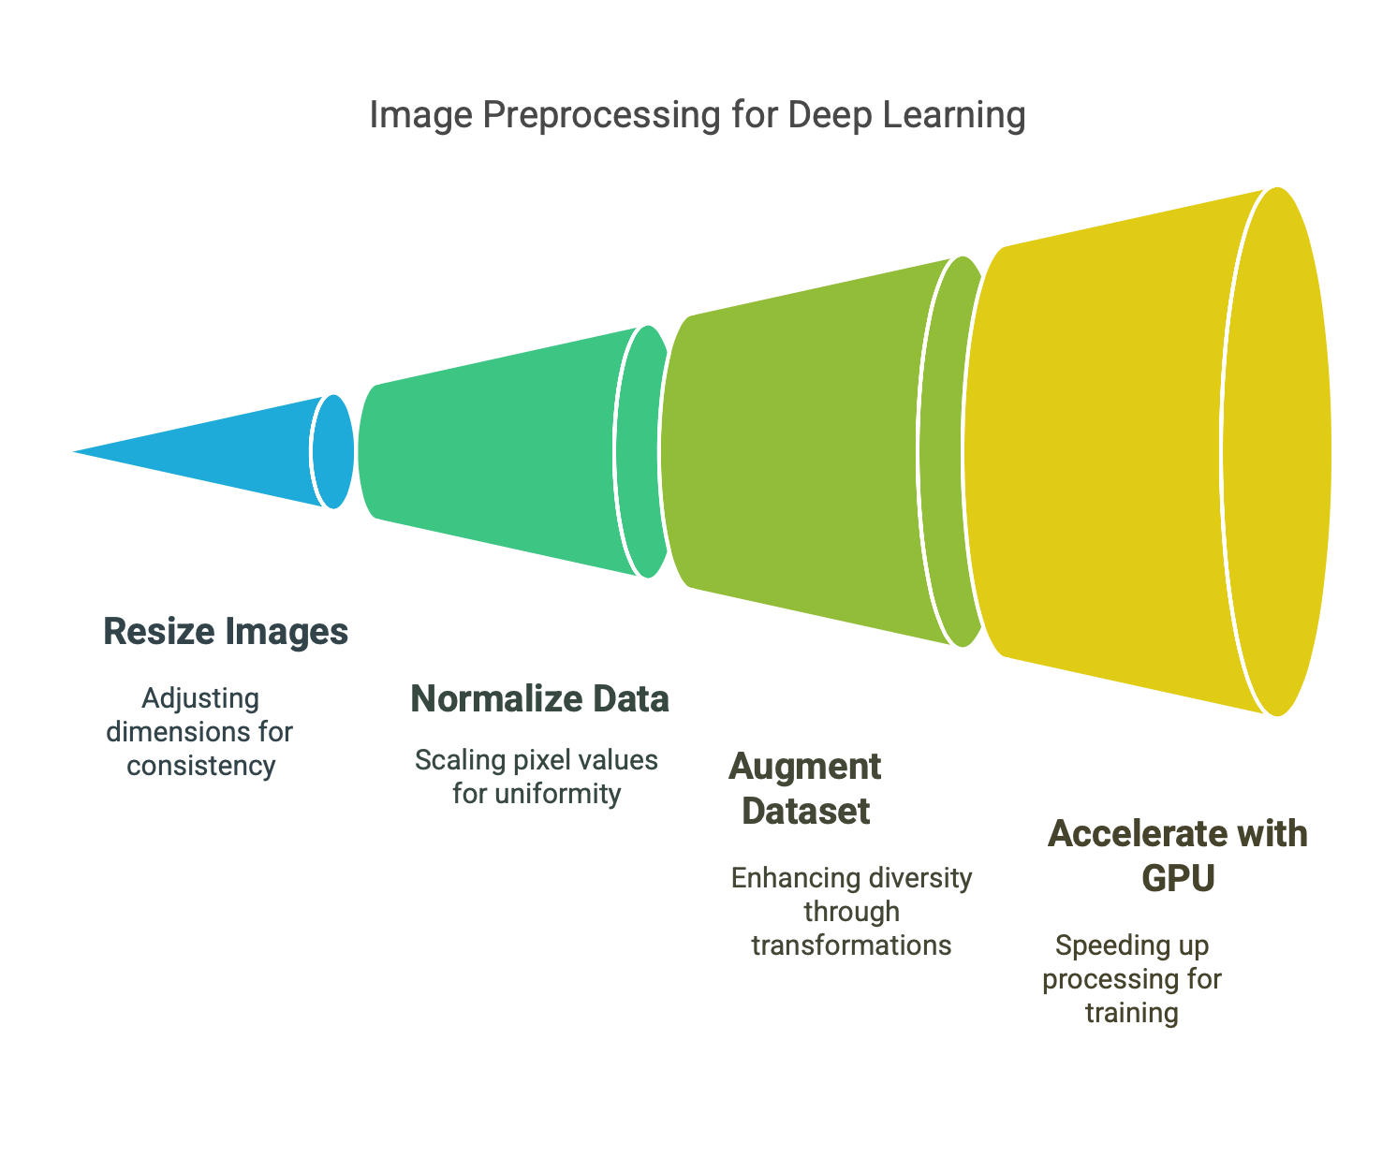
Case Studies
1 Image Preprocessing Pipeline for Deep Learning
Before feeding images into deep learning models, they must undergo a sequence of preprocessing steps to ensure consistency, improve learning efficiency, and enhance model accuracy. The image preprocessing pipeline plays a critical role in optimizing model training and performance.
Preprocessing Steps:
Resizing, normalization, and augmentation of image datasets.
GPU can significantly speed up these tasks, especially during training when large datasets are used.
Tools:
Libraries like OpenCV, TensorFlow, or PyTorch use GPU acceleration for image transformations.

Slide 31
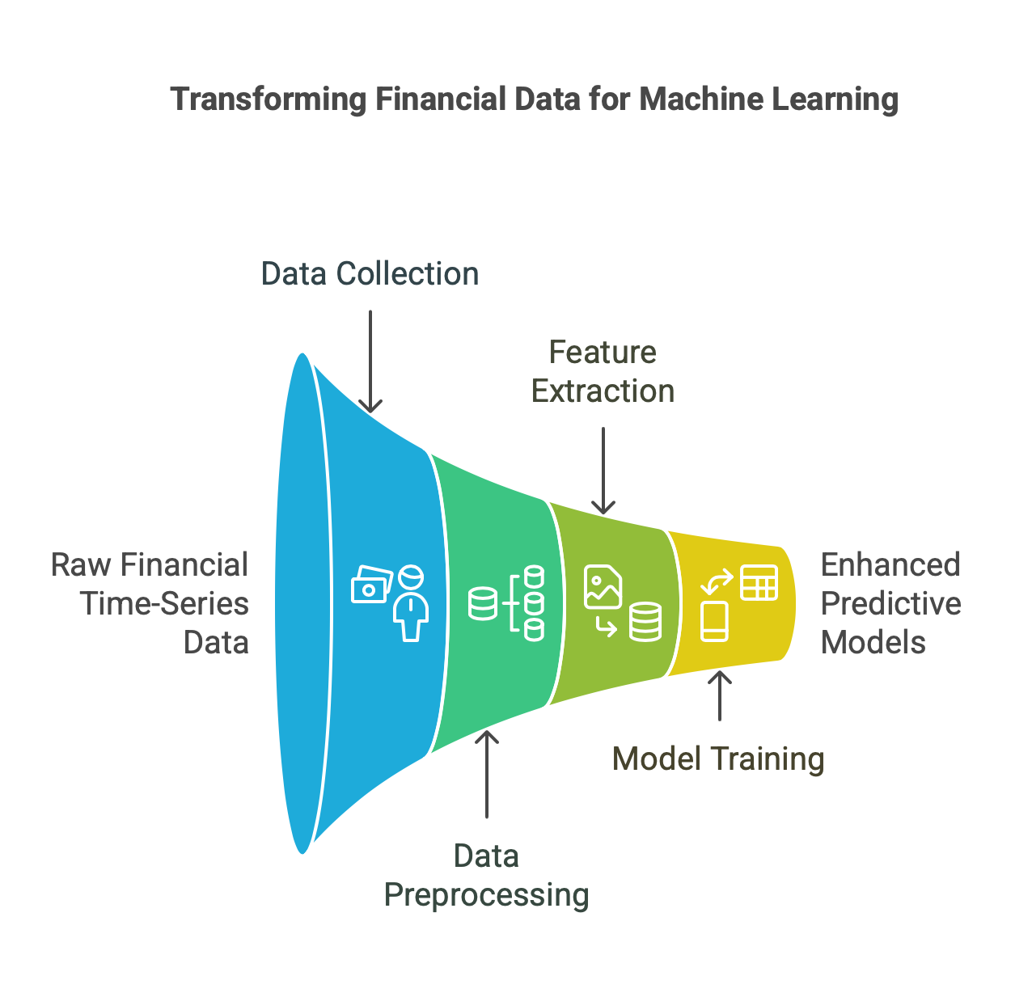
Case Studies
2. Financial Time-Series Feature Extraction
Financial time-series data consists of chronologically ordered data points representing values over time, such as stock prices, currency exchange rates, or trading volumes. Feature extraction in this context involves transforming raw time-series data into meaningful variables (features) that can be used by machine learning or deep learning models for forecasting, anomaly detection, and strategy development.
Feature Engineering in Financial Data:
Extract features like moving averages, volatility, momentum indicators, and statistical features.
GPU Acceleration:
Using parallel processing to speed up the computation of these features, especially for large datasets spanning over years of market data.

Slide 32
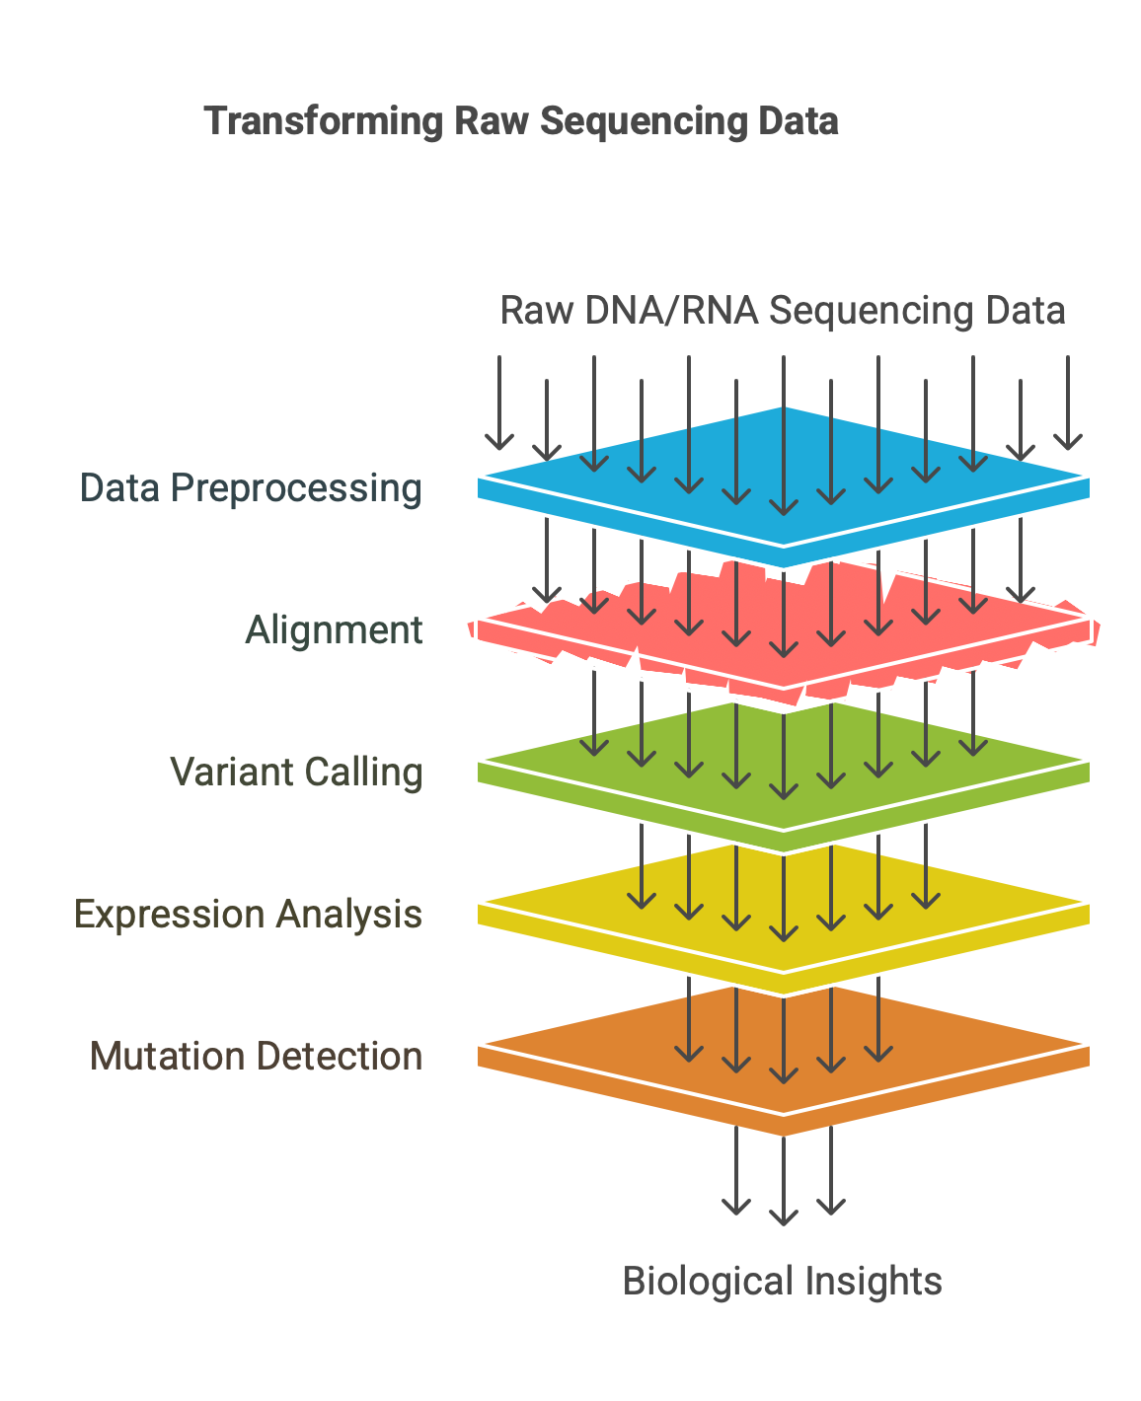
Case Studies
3. Genomic Data Processing Pipeline
A genomic data processing pipeline is a structured sequence of computational steps used to analyze raw DNA or RNA sequencing data, typically obtained from next-generation sequencing (NGS) platforms. The goal is to transform raw reads into meaningful biological insights, such as identifying genetic variants, understanding gene expression, or detecting mutations.
Processing Genomic Data:
Tasks include aligning DNA sequences, performing variant calling, and DNA sequence analysis.
GPU Optimization:
The large size of genomic datasets benefits from GPU acceleration during sequence alignment and genomic feature extraction.

Slide 33
CUDA Implementation
Memory Allocation and Transfers
Host (CPU) vs Device (GPU) memory.
Types of memory:
cudaMalloc(), cudaFree() – device memory
cudaMemcpy() – host-device transfers
Avoid excessive cudaMemcpy() calls to prevent bottlenecks.
float* d_data;
cudaMalloc(&d_data, size * sizeof(float));
cudaMemcpy(d_data, h_data, size * sizeof(float), cudaMemcpyHostToDevice);
Kernel Design Best Practices
Kernel: GPU function executed in parallel by multiple threads.
Best practices:
Use grid-stride loops.
Minimize divergence in warps.
Prefer shared memory for local thread blocks.
Avoid bank conflicts in shared memory.
__global__ void scale(float* data, float scale, int n) {
int i = blockIdx.x * blockDim.x + threadIdx.x;
if (i < n) data[i] *= scale;
}

Slide 34
CUDA Implementation
Streams and Concurrency
CUDA Streams = pipelines that allow overlapping data transfer and kernel execution.
Enable asynchronous execution.
Use cudaStreamCreate() and cudaMemcpyAsync().
cudaStream_t stream;
cudaStreamCreate(&stream);
cudaMemcpyAsync(d_data, h_data, size * sizeof(float), cudaMemcpyHostToDevice, stream);
Where,
d_data: destination pointer in device (GPU) memory.
h_data: source pointer in host (CPU) memory.
size * sizeof(float): number of bytes to copy.
cudaMemcpyHostToDevice: direction of data transfer.
stream: CUDA stream in which the copy should be scheduled.

Slide 35
Frameworks
RAPIDS is a GPU-accelerated data science ecosystem based on CUDA.
cuDF: DataFrame-like operations (like pandas but on GPU)
cuML: GPU-accelerated ML algorithms (like scikit-learn)
cuGraph: Graph algorithms (like NetworkX but GPU-based)
TensorFlow Data API with GPU
TensorFlow pipelines can be GPU-accelerated using tf.data API and efficient tf.function.
PyTorch DataLoader Optimizations
Use num_workers > 0 and pin_memory=True in DataLoader.
Move batches to GPU using .to(device).

Slide 36
CPU Vs GPU accelerated Approach
Topic | CPU Approach | GPU Accelerated Approach
Memory Handling | Simple but slower | Needs management but faster
Data Processing (ETL) | Pandas + NumPy | cuDF + cuML
Model Training | scikit-learn | cuML / TensorFlow / PyTorch
Parallel Execution | Limited | Massive via thousands of cores

Slide 37
Performance Optimization

Slide 38
Performance Optimization Benchmarking and Profiling 1 Importance of Benchmarking and Profiling Benchmarking helps measure performance under specific workloads.Profiling allows fine-grained analysis of code execution. Goals:Identify performance bottlenecks Understand memory and compute usage Improve throughput and resource utilization 2 NVIDIA Nsight Tools Nsight Systems: System-wide profiling (CPU + GPU interactions) Nsight Compute: Kernel-level analysis Visual interface for timeline, API calls, memory usage, etc. Sample Use (Nsight Compute) nv-nsight-cu-cli ./my_cuda_app Use with flags for specific metrics.

Slide 39
Performance Optimization contd.. Benchmarking and Profiling 3 CUDA Profiler Metrics Occupancy: Ratio of active warps to max possible Memory Throughput: Global, shared, L2 cache bandwidth Instruction Throughput: How fast instructions are issued Warp Execution Efficiency: % of threads active in warps Tools: nvprof (deprecated), ncu, Nsight GUI 4 Identifying Bottlenecks Compute-bound: Focus on kernel optimization Memory-bound: Address access patterns and bandwidth Latency-bound: Look into kernel launch, synchronization delays

Slide 40
Optimization Techniques
1 Memory Access Patterns Coalesced Access: Consecutive threads access consecutive memory addresses Avoid strided or unaligned access
// Good: Coalesced
int idx = threadIdx.x + blockDim.x * blockIdx.x;
a[idx] = b[idx];
// Bad: Strided
int idx = threadIdx.x + blockDim.x * blockIdx.x;
a[idx] = b[idx * 2];
2 Kernel Fusion
Combine multiple small kernels into one to reduce memory access and kernel launch overhead
Reduces global memory transactions
Use shared memory to combine operations within a single kernel

Slide 41
Optimization Techniques contd..
3 Asynchronous Execution
Use streams to overlap computation and data transfer
Enable concurrency with cudaMemcpyAsync and multiple streams
Example:
cudaMemcpyAsync(dst, src, size, cudaMemcpyHostToDevice, stream)
my_kernel<<<blocks, threads, 0, stream>>>(...)
4 Multi-GPU Strategies
Data Parallelism: Split data across GPUs
Model Parallelism: Split model/layers across GPUs
Use NCCL (NVIDIA Collective Communication Library) for efficient communication
PyTorch Example (Data Parallelism):
from torch.nn import DataParallel
model = DataParallel(model)

Slide 42
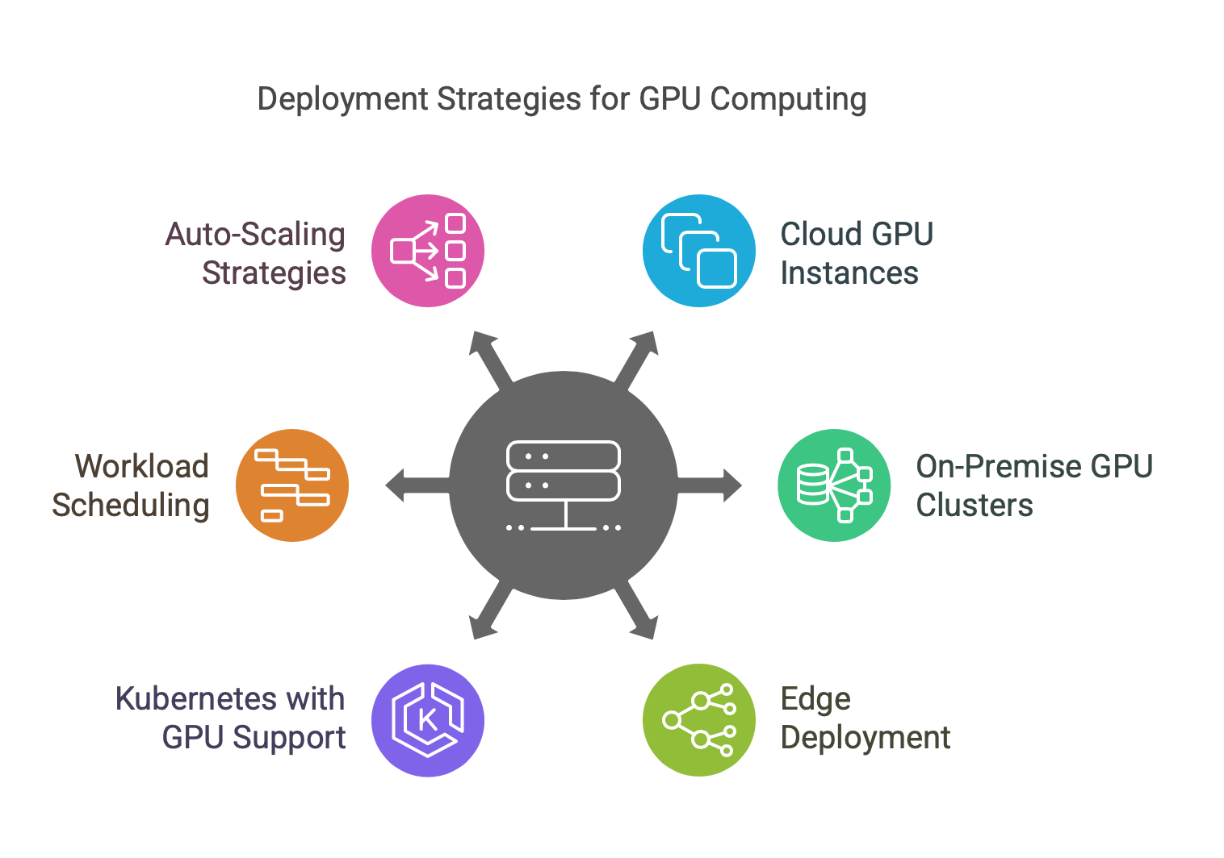
Deployment Strategies
Deployment Environments
Cloud GPU instances (AWS, GCP, Azure)
On-premise GPU clusters
Edge deployment considerations
Orchestration and Scaling
Kubernetes with GPU support
Workload scheduling
Auto-scaling strategies

Slide 43
Cloud GPU Instances (AWS, GCP, Azure)
AWS GPU Instances:
P4/P3 (Tesla T4/V100) – Inference & Training
G5 (A10G) – Graphics & ML
EC2 Spot Instances for cost savings
GCP GPU Options:
T4, V100, A100 on Google Compute Engine
TPU v4 Pods for large-scale training
Azure GPU Offerings:
NCv3 (V100), ND (A100)
Azure ML Pipelines for MLOps

Slide 44
On-Premise GPU Clusters
An on-premise GPU cluster is a group of GPU-equipped servers physically located and maintained within an organization's own data center or facility. These clusters are networked together and configured to run parallel computing tasks, typically for machine learning, deep learning, scientific simulations, or high-performance computing (HPC).
NVIDIA DGX Systems (A100, H100)
Kubernetes + GPU Operator for cluster management
Storage Considerations:
NVMe for fast I/O
Distributed FS (Lustre, CephFS)

Slide 45
On-Premise GPU Clusters Advantages & Challenges
Advantages
Full Control: You can configure hardware/software to meet specific needs.
Data Security: Sensitive data stays within your network, reducing external threats.
No Ongoing Cloud Costs: Pay upfront for hardware—no recurring charges like cloud providers.
Challenges
High Initial Cost: Upfront investment in hardware and infrastructure.
Maintenance Overhead: Requires skilled IT staff for updates, hardware failures, and scaling.
Scalability: Adding new nodes requires physical setup and configuration.

Slide 46
Edge Deployment Considerations
Deploying AI models on edge devices means running them directly on hardware that's close to the data source (like cameras, sensors, or IoT devices), rather than on centralized cloud servers. This brings unique challenges and opportunities.
NVIDIA Jetson: Embedded AI Platforms
NVIDIA Jetson boards are small yet powerful GPU-accelerated devices designed for edge AI. Key models include:
Jetson Orin:
Most powerful in the Jetson family
Suitable for high-throughput edge AI (e.g., real-time object detection with deep models)
Jetson Xavier:
Balance of performance and efficiency
Used in smart cities, robotics, drones
Jetson Nano:
Entry-level, ideal for simple AI applications and prototypes

Slide 47
Edge Deployment Considerations
Latency & Bandwidth Constraints
Edge deployment must handle real-time requirements and limited connectivity:
Low Latency: Inference needs to be quick (e.g., in autonomous vehicles or surveillance).
Limited Bandwidth: Can't rely on cloud APIs—must process data locally.
Offline Capability: Devices often operate with intermittent or no internet.

Slide 48
Model Optimization Techniques
Running models efficiently on edge hardware requires reducing model size and inference time:
a. Quantization
Convert model weights/activations from FP32 → FP16 or INT8
Reduces model size and speeds up inference
Minimal accuracy drop with good calibration
# Example in PyTorch
torch.quantization.convert(model, dtype=torch.qint8)
b. TensorRT (NVIDIA)
NVIDIA’s inference optimizer and runtime for deep learning models
Converts and optimizes models (from PyTorch, TensorFlow, ONNX)
Supports:
Layer fusion
Precision calibration (FP16/INT8)
Dynamic batching
Kernel auto-tuning
# Convert ONNX to TensorRT engine
trtexec --onnx=model.onnx --saveEngine=model.trt --fp16

Slide 49
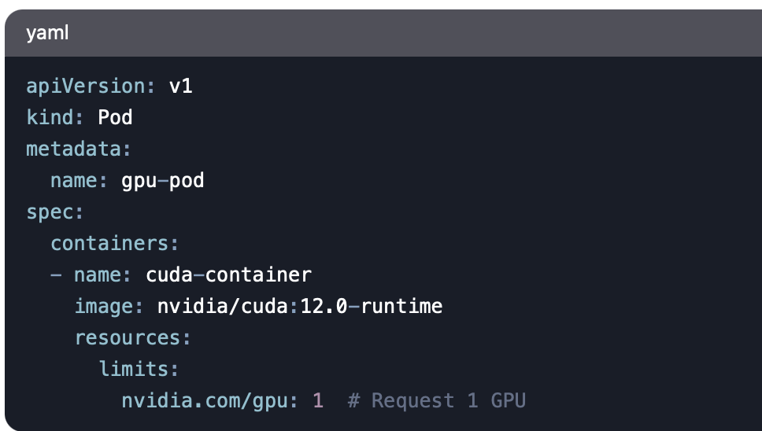
Model Optimization Techniques
Kubernetes with GPU Support
Key Components:
NVIDIA GPU Operator (automates driver install)
Node Feature Discovery (NFD) for GPU detection
Example YAML for GPU Pod:

Slide 50
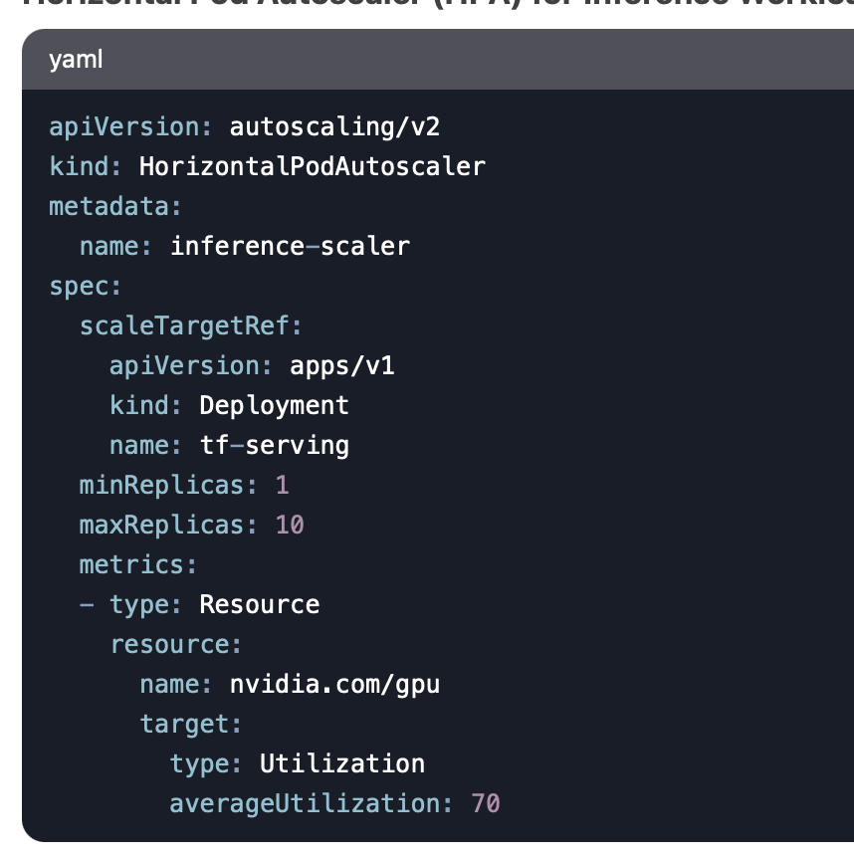
Model Optimization Techniques
Workload Scheduling
GPU-Aware Scheduling:
Kubernetes Device Plugins
Gang Scheduling (for multi-GPU jobs)
Example: Kubeflow for ML Workloads
Auto-Scaling Strategies
Cluster Autoscaler + GPU Nodes
Horizontal Pod Autoscaler (HPA) for Inference Workloads

Slide 51
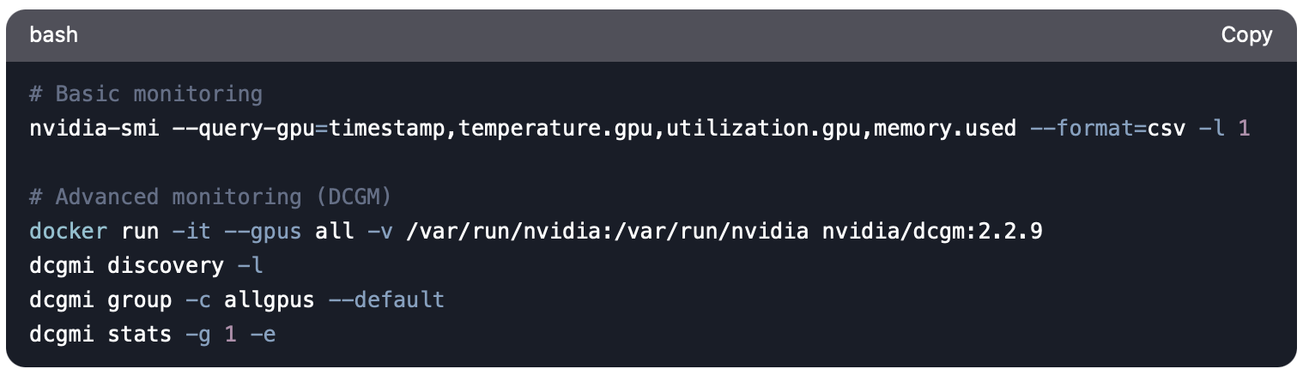
Monitoring and Maintenance of GPU-Accelerated Systems GPU Health Monitoring Essential Metrics to Track: Temperature (GPU Core Temp) Power draw (Power Consumption) ECC Memory Errors Fan speed (Fan Speed %)
Alert Thresholds Table:
Metric | Warning Threshold | Critical Threshold
Temp | 80°C | 90°C
Power | 90% TDP | 100% TDP
Memory | 90% usage | 95% usage

Slide 52
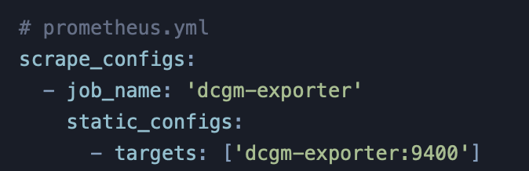
Model Optimization Techniques Grafana Dashboard Example 1. GPU Utilization Heatmap 2. Memory Bandwidth Timeline 3. Error Rate Monitoring
Performance Metrics Collection
Key Metrics:
GPU Utilization (utilization.gpu)
Memory Usage (memory.used/memory.total)
SM Occupancy
PCIe Throughput
Monitoring Stack:
Prometheus + Grafana Setup

Slide 53
Error Handling and recovery
Common GPU Errors:
CUDA_ERROR_ILLEGAL_ADDRESS
CUBLAS_STATUS_ALLOC_FAILED
NVML_ERROR_THERMAL_VIOLATION
OOM (Out-of-Memory), CUDA kernel crashes, driver timeouts
Recovery Strategies:
Automated job retries with checkpointing
Fallback strategies (e.g., lower batch size)
Logging/alerting (Sentry, ELK Stack)

Slide 54
Cost Optimization
1. GPU Utilization Tracking
Goal: Maximize ROI by avoiding idle resources
Methods:
Real-time dashboards (Grafana)
Historical analysis (e.g., peak vs. off-peak usage)
Optimization:
Dynamic scaling (Kubernetes, Slurm)
Multi-tenancy (shared GPUs for small jobs)
2. Spot Instance Strategies
Cloud-Specific Tactics:
AWS: Spot Blocks for critical jobs
GCP: Preemptible VMs + checkpointing
Azure: Low-priority VMs with fault tolerance
Best Practices:
Diversify instance types
Hybrid on-demand/spot fleets

Slide 55
Cost Optimization contd..
3. Mixed-Precision Techniques
Mixed-precision computing means using different numerical formats (like FP32, FP16, INT8) within the same model or computation to improve performance and reduce memory usage, without sacrificing much accuracy.
In mixed-precision training:
Weights and activations are stored in FP16
Accumulation (e.g., gradients, losses) is done in FP32 for numerical stability
How It Saves Costs:
Faster training → lower compute time
Implementation:
NVIDIA AMP (Automatic Mixed Precision)
TF32 (TensorFloat-32) for matrix ops
Caveats:
Verify model stability (gradient scaling)

Slide 56
Academic References
"Efficient GPU Resource Management" (MLSys 2023)
NVIDIA "Best Practices for GPU Operations" Whitepaper
AWS "Cost Optimization for ML Workloads" Guide

Slide 57

















الشراكات العالمية

Slide 58
شــــــكــــرًا لكــــــم
THANK YOU

